Slide 1


Cement Demand Forecasting & Inventory Optimization
Random Forest Forecasting Analysis for Site-Level Operational Insights
PRESENTED
BY
FELIX ONWUDIWE
MAY 2026

Slide 2
Project Objective
Develop a machine learning model to forecast cement demand across multiple construction sites.
Analyze operational drivers influencing cement consumption.
Simulate inventory performance and identify potential inventory risk locations.
Support data-driven planning and decision-making for operations teams.

Slide 3
Project Methodology
Collected and prepared operational, weather, and inventory datasets.
Performed exploratory data analysis and feature engineering.
Built and evaluated forecasting models including Random Forest and SARIMAX.
Selected Random Forest based on superior RMSE, MAE, and R² performance.
Generated site-level inventory simulations and dashboard visualizations.

Slide 4
Model Performance Summary
Random Forest achieved the best forecasting performance among the evaluated models.
RMSE: 0.71(Very low Prediction error)
MAE: 0.16 (Minimal Difference between Actual & Predicted Demand)
R² Score: 0.998 (Model Accuracy is approximately 99.8%)
The model successfully captured operational demand fluctuations across observations.

Slide 5
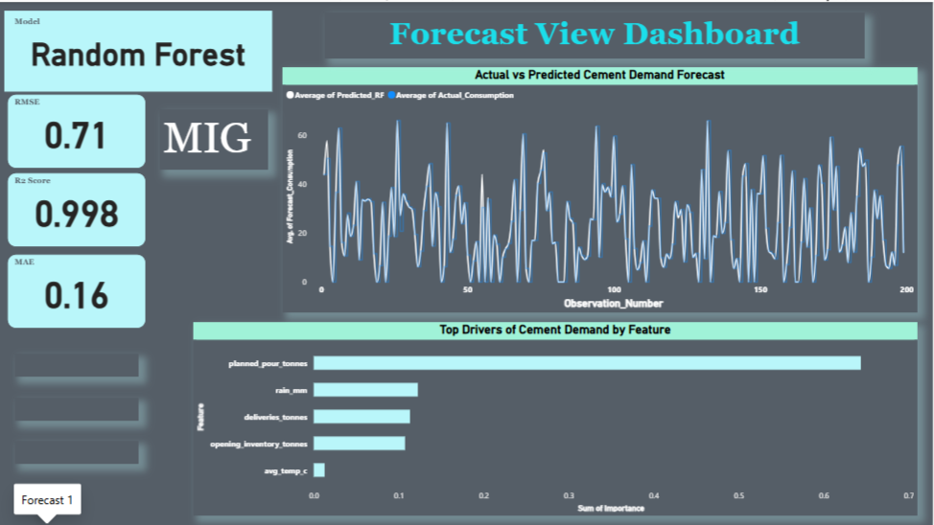
DASHBOARD OVERVIEW

Slide 6
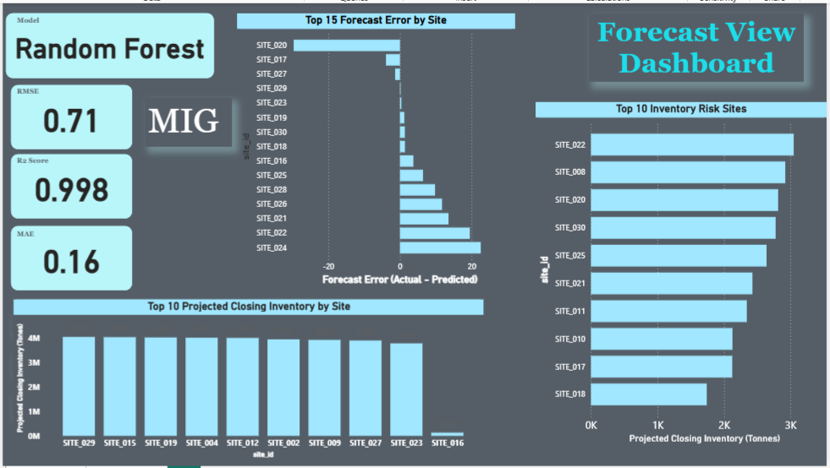
DASHBOARD OVERVIEW

Slide 7

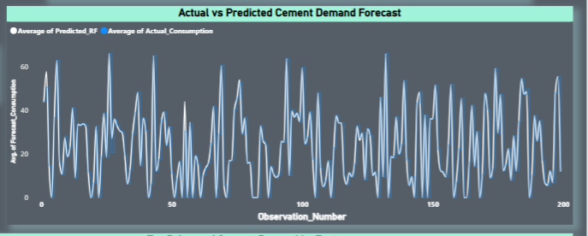



Actual vs Predicted Cement Consumption
Random Forest predictions closely follow actual cement consumption trends.
The model captures demand fluctuations effectively.
Low RMSE and MAE indicate strong forecasting performance.
The chart demonstrates that the Random Forest model successfully captured cement demand trends across observations.”.

Slide 8
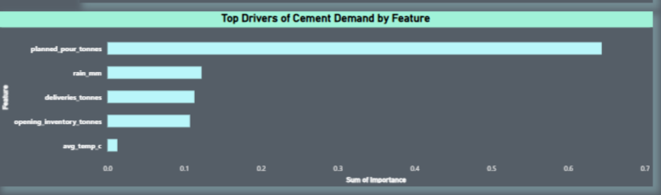
Random Forest Feature Importance
Planned pour tonnes was the strongest demand driver.
Rainfall, deliveries, and opening inventory also influenced demand.
Temperature contributed minimally to prediction performance.
The analysis highlights the key factors driving cement demand prediction.

Slide 9
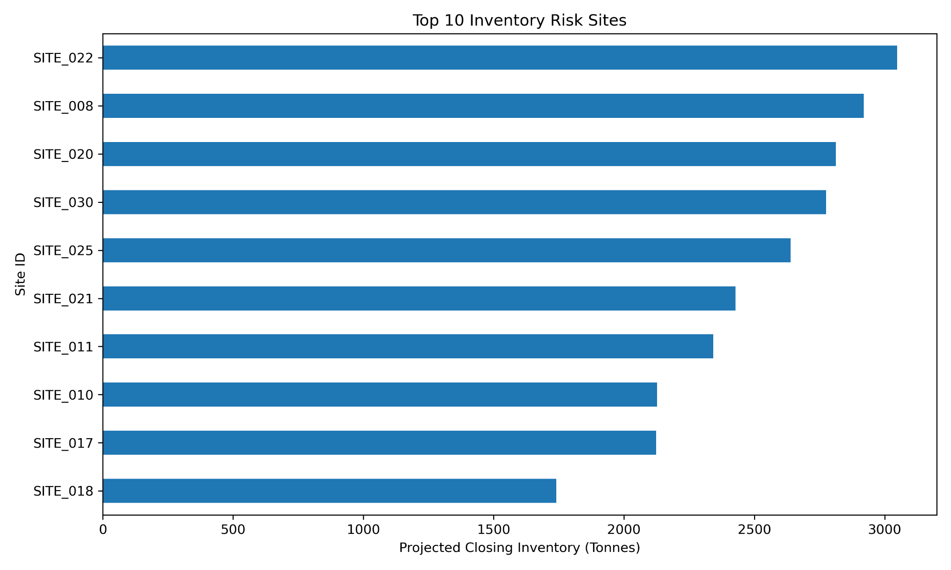
Top 10 Inventory Risk Sites
SITE_022 and SITE_008 recorded the highest inventory risk levels.
Low projected inventory may indicate potential stock shortages.
The chart supports proactive inventory planning decisions.
These insights support proactive inventory replenishment and risk mitigation.

Slide 10
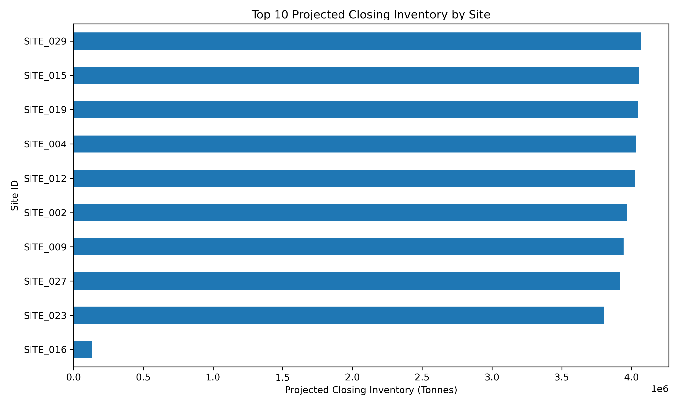
Top 10 Projected Closing Inventory by Site
Several sites maintained projected inventory above 3.8 million tonnes.
SITE_016 had significantly lower projected inventory.
The chart provides operational visibility into projected inventory distribution across major sites.

Slide 11
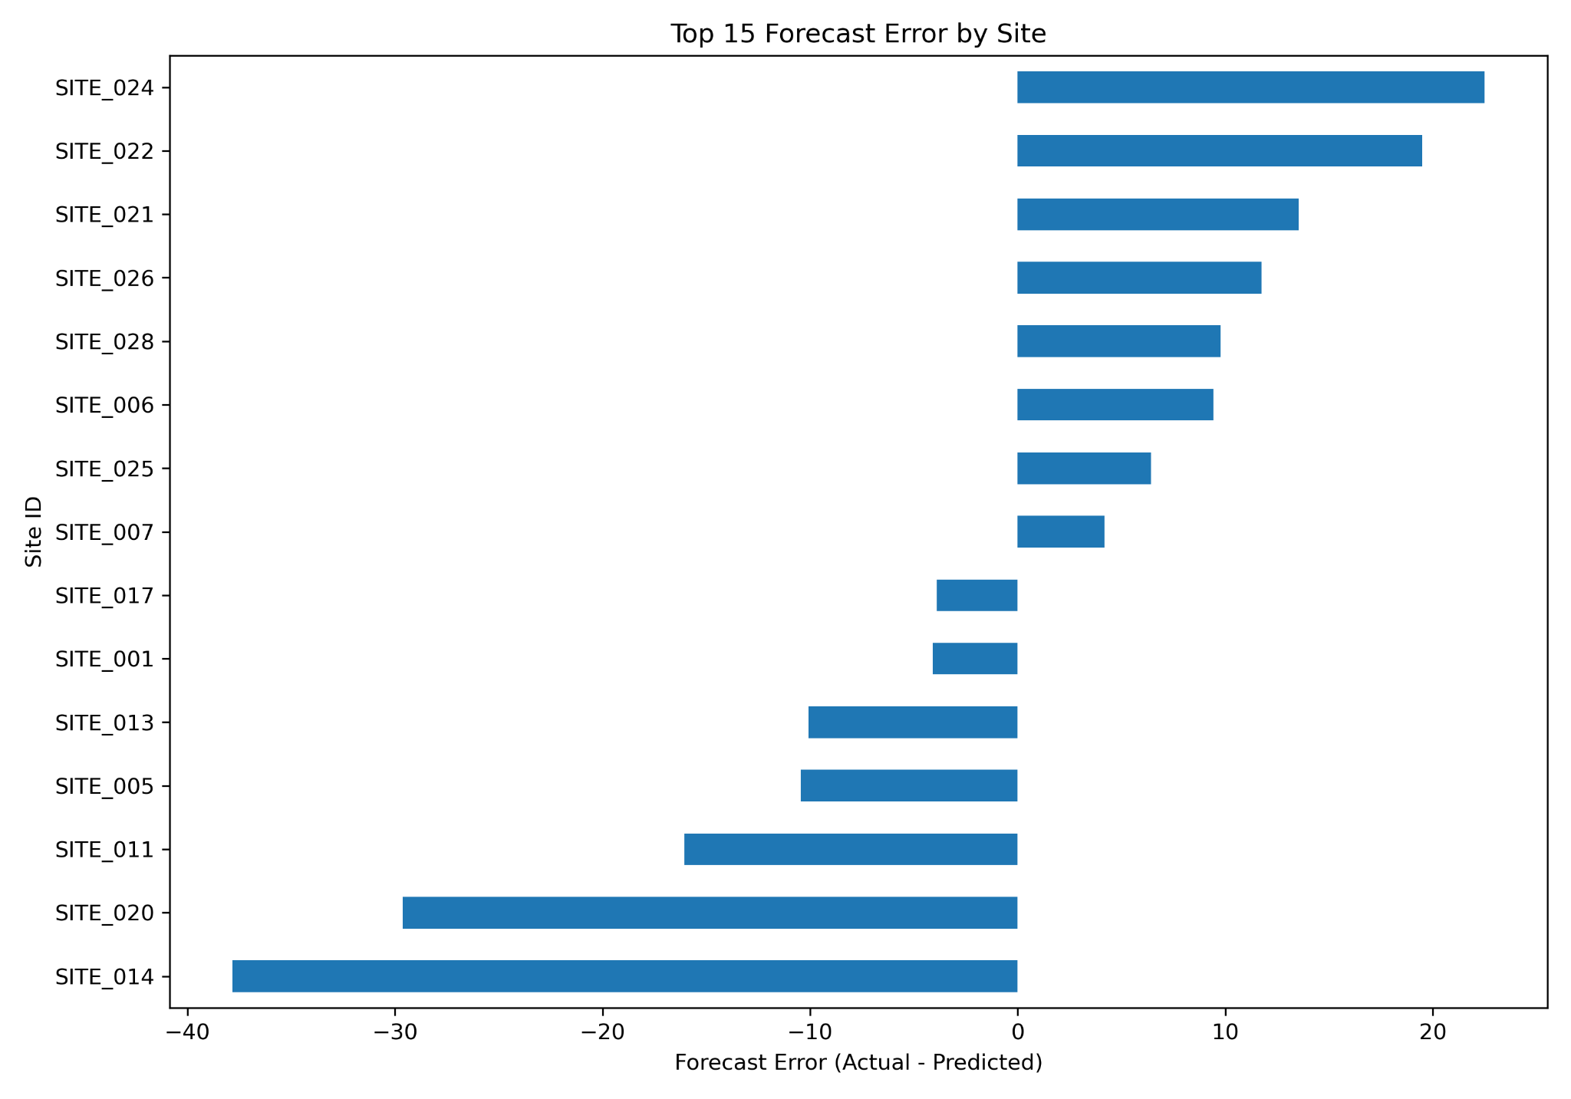
Top 15 Forecast Error by Site
SITE_014 and SITE_020 showed the highest negative forecast errors.
SITE_024 and SITE_022 recorded the largest positive forecast errors.
The chart identifies locations requiring model calibration improvements.
The chart helps identify locations requiring forecast review and operational adjustments.

Slide 12
Business Impact & Insights
Improved visibility into site-level inventory performance.
Enabled early identification of inventory risk locations.
Provided operational insights for inventory balancing and replenishment.
Supported proactive planning through forecast error analysis.

Slide 13

Recommendations
Monitor high-risk inventory sites regularly to prevent stock shortages.
Review sites with large forecast errors for operational anomalies.
Continue integrating weather and operational variables into forecasting.
Expand the solution into a real-time Power BI operational dashboard.
Implement periodic model retraining for improved forecasting accuracy.

Slide 14
Conclusion
The Random Forest forecasting solution successfully predicted cement demand with high accuracy.
Inventory simulation provided valuable site-level operational insights.
The dashboard supports data-driven decision-making for project management and operations teams.
The solution establishes a scalable foundation for future predictive analytics initiatives.

